Slide 1

Análisis de señales
Operaciones sobre señales(Unidad 2)
Ignacio Andrade Salazar

Slide 2
Select the true relation:
f1=(1/2x,y)
f
f1
Please, try to find the answer using MATLAB. Thanks

Slide 3
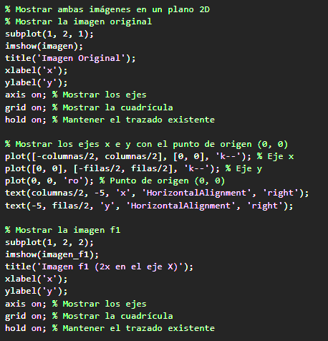
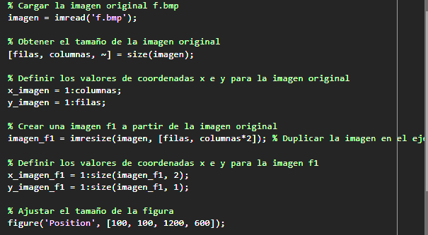
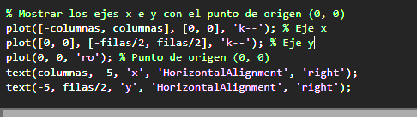
CODIGO

Slide 4
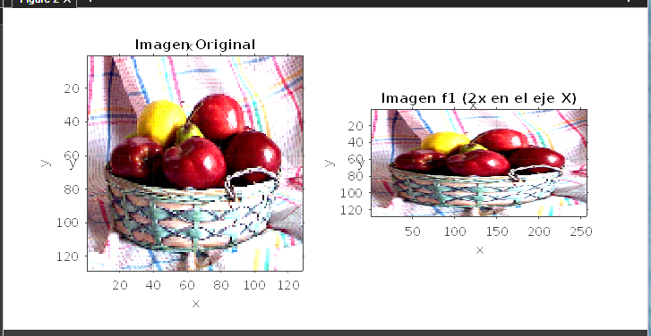

Slide 5
True or false ?:
false
f
f1
Please, try to find the answer using MATLAB. Thanks

Slide 6
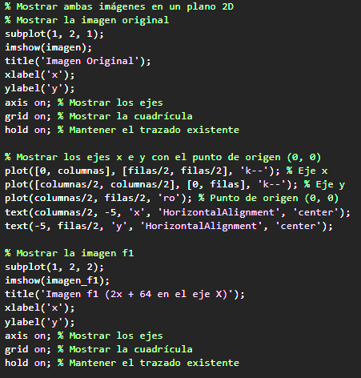
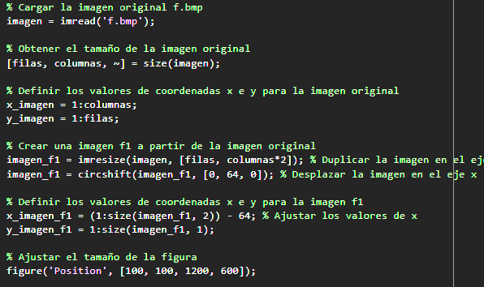
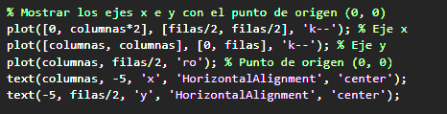

Slide 7
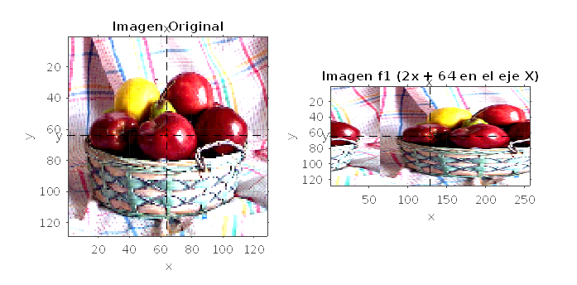

Slide 8
Select the true relation:
a
f
f1
Please, try to find the answer using MATLAB. Thanks

Slide 9
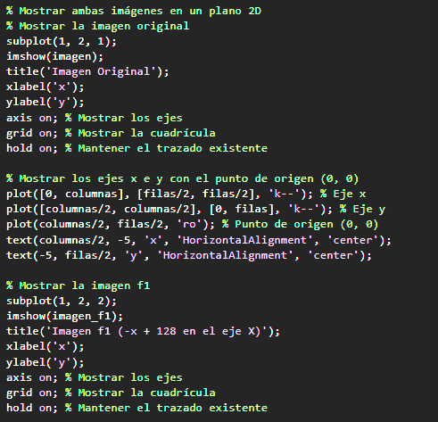
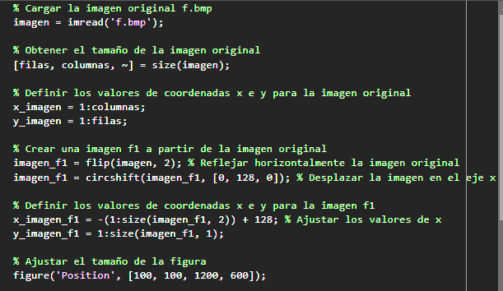
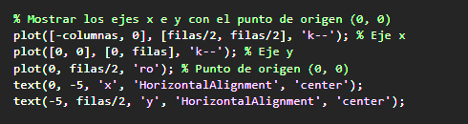

Slide 10
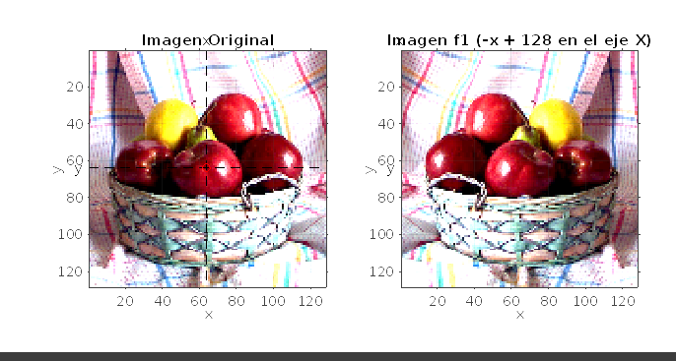

Slide 11
True or false ?:
false
f
f1
Please, try to find the answer using MATLAB. Thanks

Slide 12
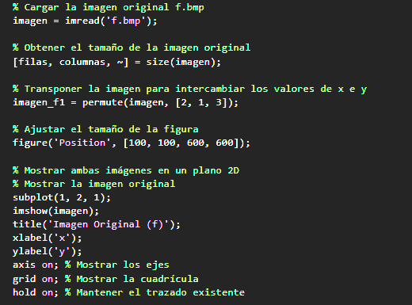
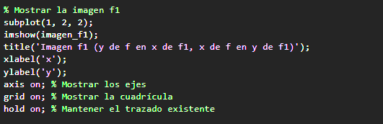

Slide 13
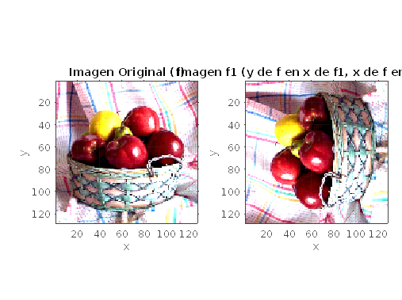

Slide 14
Select the true relation:
a
f
f1
Please, try to find the answer using MATLAB. Thanks

Slide 15
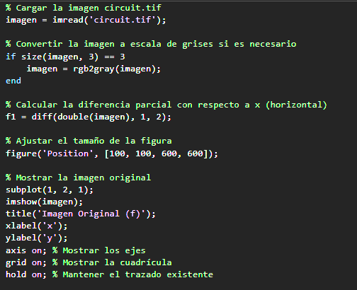
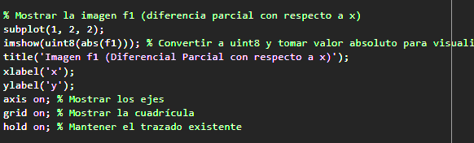

Slide 16
